Slide 1
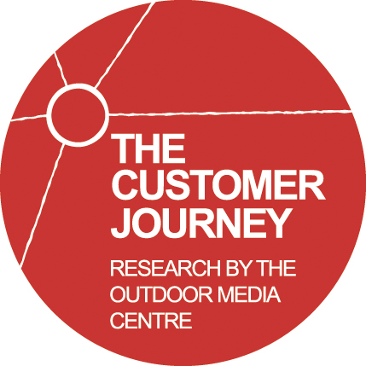


Slide 2




The 4 customer journey stages
Taking in information passively about products and services but not doing anything with that information yet
Researching your options by educating and informing yourself about the category, working up a shortlist
Working out where to buy the product or service you want, which brand to buy, how much to pay
Have recently bought and are sharing your thoughts with other people and reviewing your purchase

Slide 3

Static stage
Nationally representative online sample of 1,507 GB adults
Asked about all the sources they use, including advertising, search and social media
Freeze frame snapshot in time
Fieldwork by ICM

Slide 4
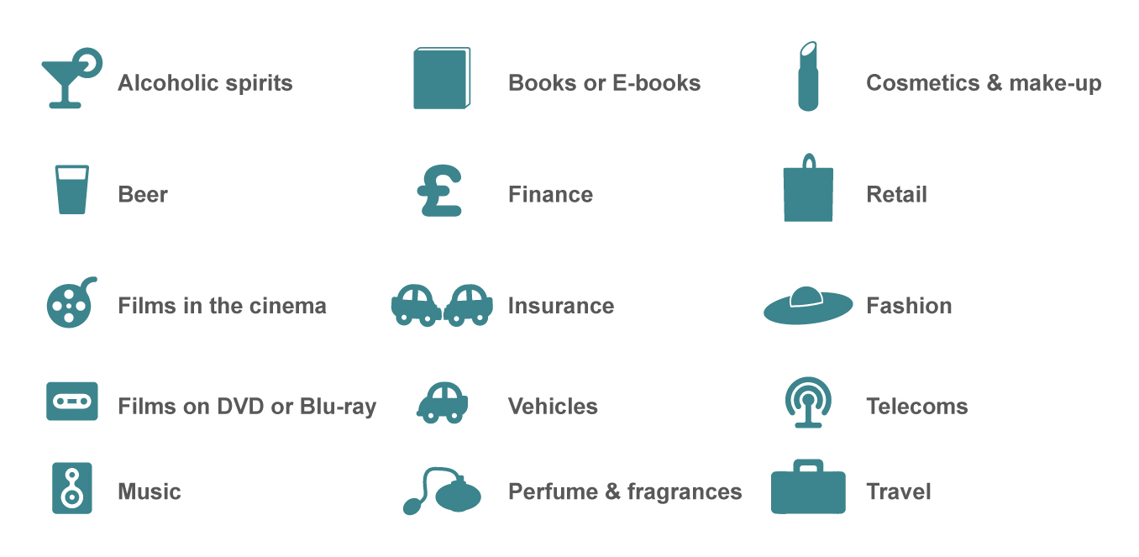
Categories reviewed in static stage

Slide 5

Ads seen/heard in the last month?
7 in 10 have seen OOH ads

Slide 6

OOH-exposed people more likely to act on ads
Those seeing OOH ads are much more likely to learn about companies they’ve seen advertised, and look at products they’ve seen advertised, than people who haven’t

Slide 7
Two thirds have searched the web as a direct result of OOH ads
At home or at work
On a smart phone or tablet

Slide 8
More OOH exposures in past month lead to more searches, and more purchases
Notes:
No OOH 1 OOH 2 OOH 3 OOH 4 OOH 5+ OOH
Search internet at home / work n/a 47% 55% 51% 61% 78%
Search internet when mobile n/a 9% 7% 10% 11% 17%
Search internet anywhere n/a 50% 58% 55% 64% 82%
Buy because of OOH n/a 25% 26% 34% 34% 58%
Recall: in street 38% 49% 65% 72% 76% 78%
Recall: bus sides 29% 46% 64% 71% 83% 84%
Recall: bus shelters 23% 34% 46% 52% 64% 73%
Recall: retail estate 31% 39% 40% 48% 61% 62%
Recall: Underground 7% 9% 13% 20% 20% 42%
Recall: Trains 5% 8% 6% 13% 20% 34%

Slide 9

1 in 3 have bought because of
OOH advertising
Notes:
Although only 13% have bought because of any advertising seen in the last month, 35% of people have bought at some point in their life because of out-of-home

Slide 10

Young, mobile, affluent, urban, connected most likely to buy because of OOH
High earners
18 to 24 year olds
25 to 44 year olds
Urban dwellers
Commuters: 6-9 hours/week travel and especially 9+ hours/week
Connected people:
smart phones and tablets
Notes:
High earners: 39%
Age: 16-24= 44%, 25-44 = 40%, 45-64 = 23%
Cities: 43%
Travel: <3 hours = 29%, 3-6 hours = 30%, 6-9 hours = 36%, >9 hours = 48%
Devices: Neither = 27%, Smart phone = 42%, Tablet = 49%

Slide 11
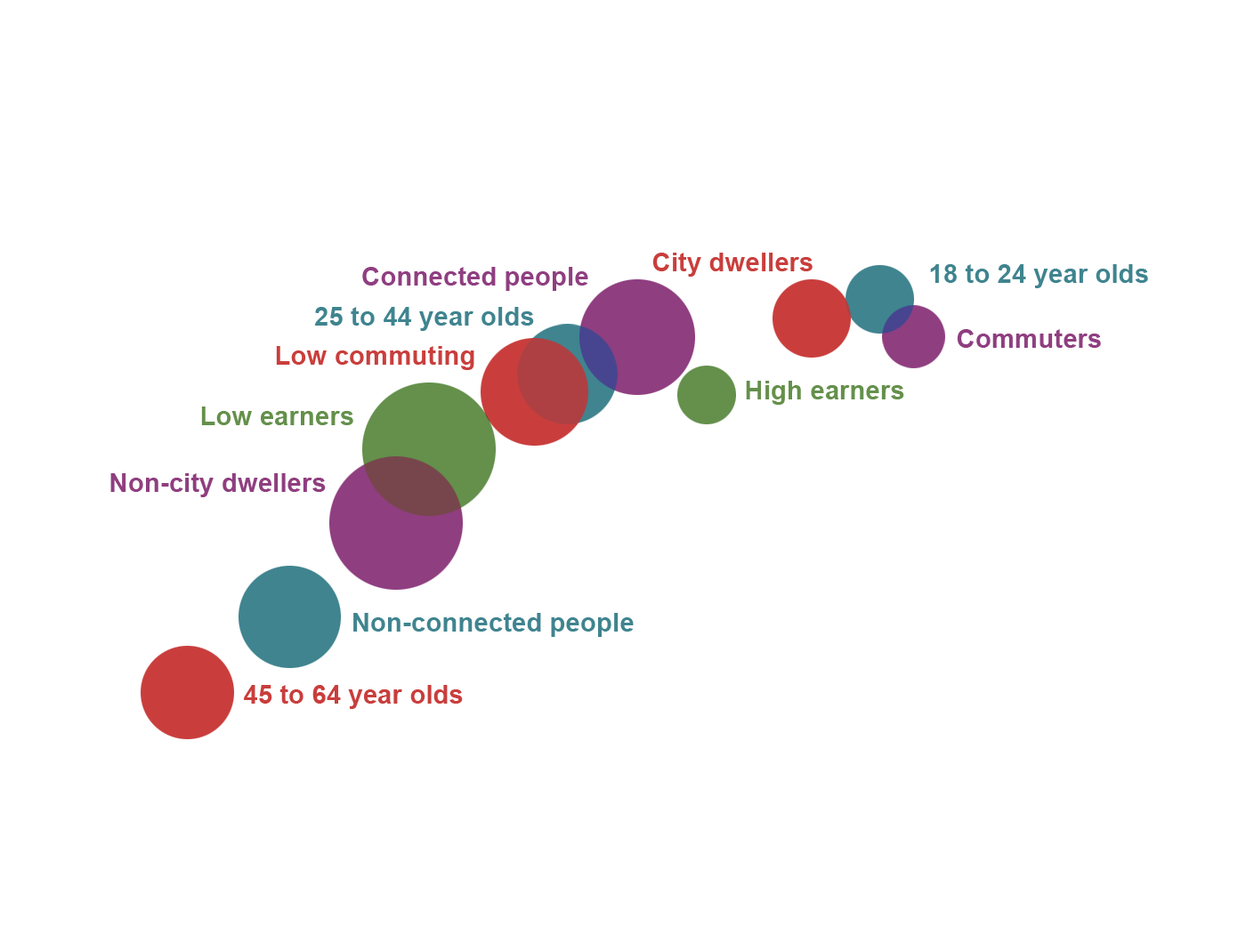
Groups most responsive to OOH
Buy because of OOH a lot
Notice OOH advertising a lot

Slide 12

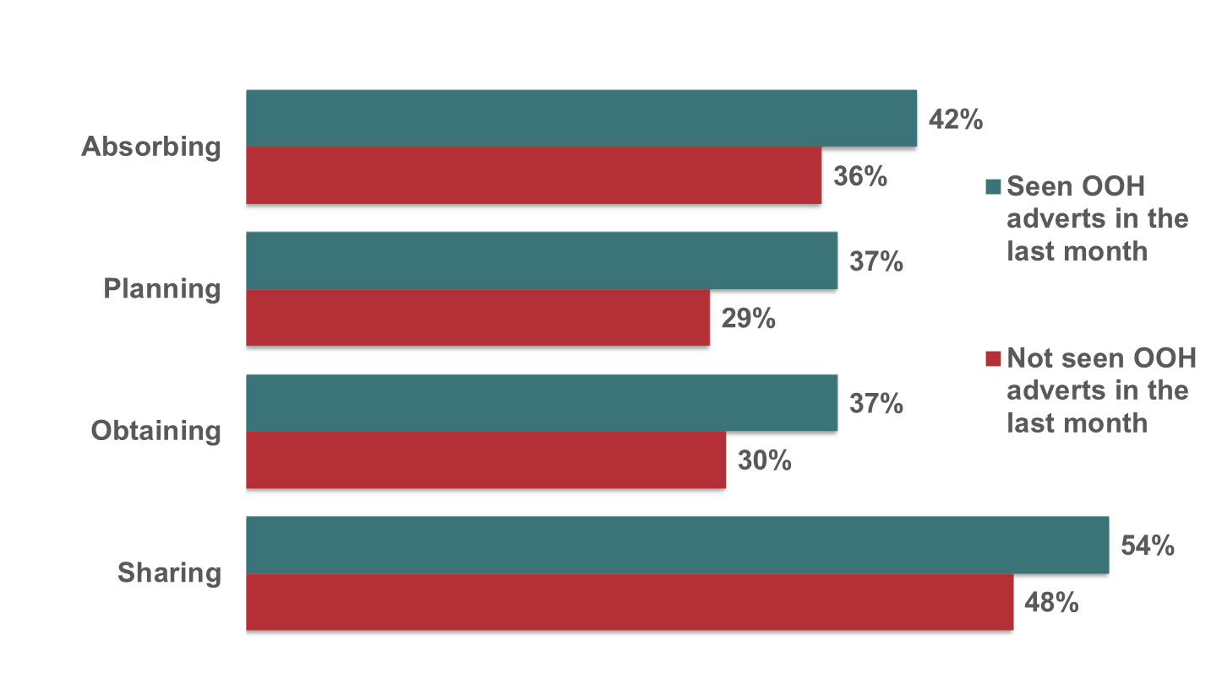
OOH-exposed correlated to social media use (i.e. using or planning to use social media websites) at each phase, especially Sharing

Slide 13

Conclusion from static phase
The most OOH responsive are young, mobile, urban, affluent, connected
OOH is strongly linked to search including mobile
The OOH exposed are more involved in social media
More OOH exposures drive positive investigating and buying actions

Slide 14

The Dynamic phase
How do people move between the phases of the customer journey? What drives the journey: advertising or other influences like WOM?
Fieldwork through On Device Research
2,141 selected to complete a 2-week mobile diary – 27,833 diary days
9 product categories covered in diary phase
Panellists asked to ‘check-in’ and report all brand encounters in their categories
Pre and post profiling survey determined which phase they started and ended in
RE-PROFILING
PROFILING
DIARY

Slide 15
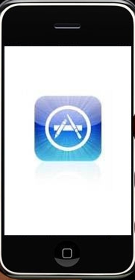
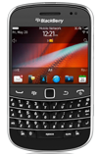
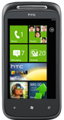
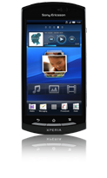
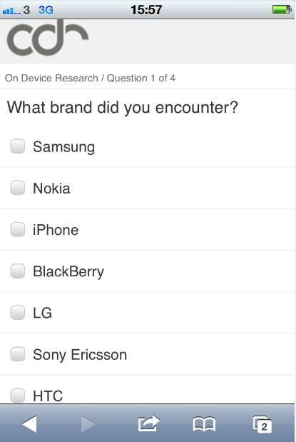
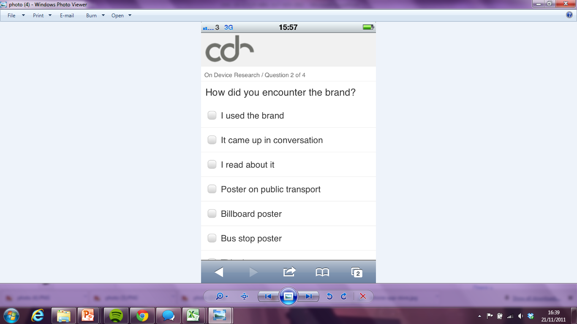
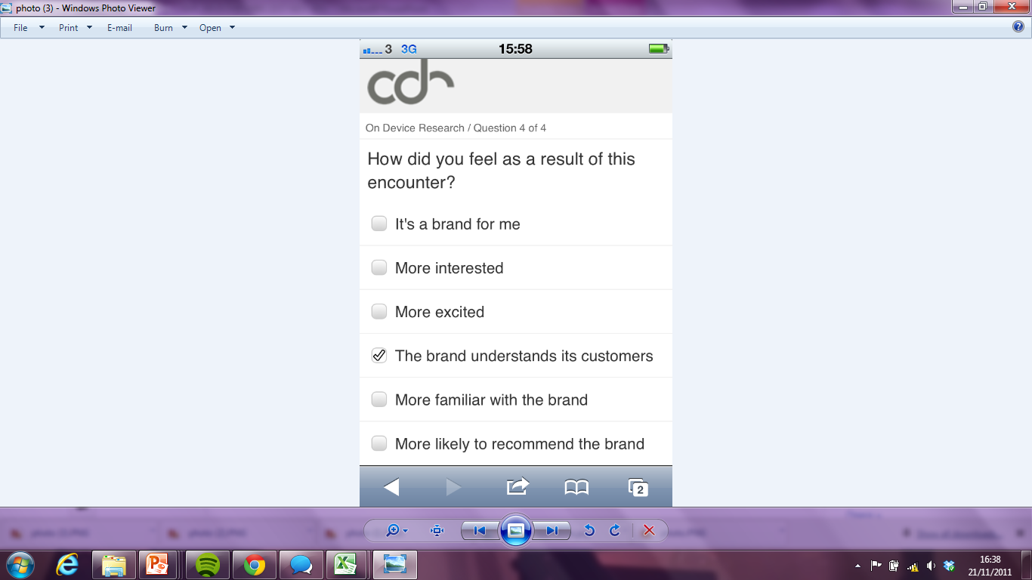
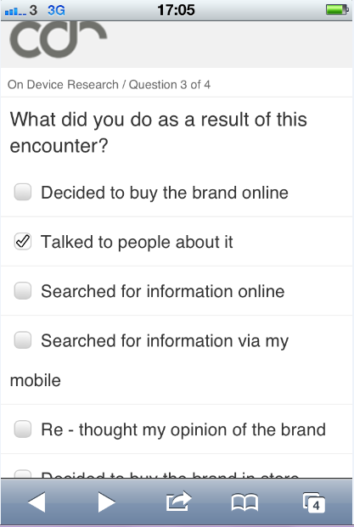
Dynamic fieldwork task: record category stimuli: brand, message type, reaction
Which brand encountered?
How
encountered?
Feeling as a result of the encounter
What done as a result of the encounter
Diary n=2,141
On Device Research methodology ensures correct representation in diary sample of both SmartPhone and FeaturePhone users

Slide 16
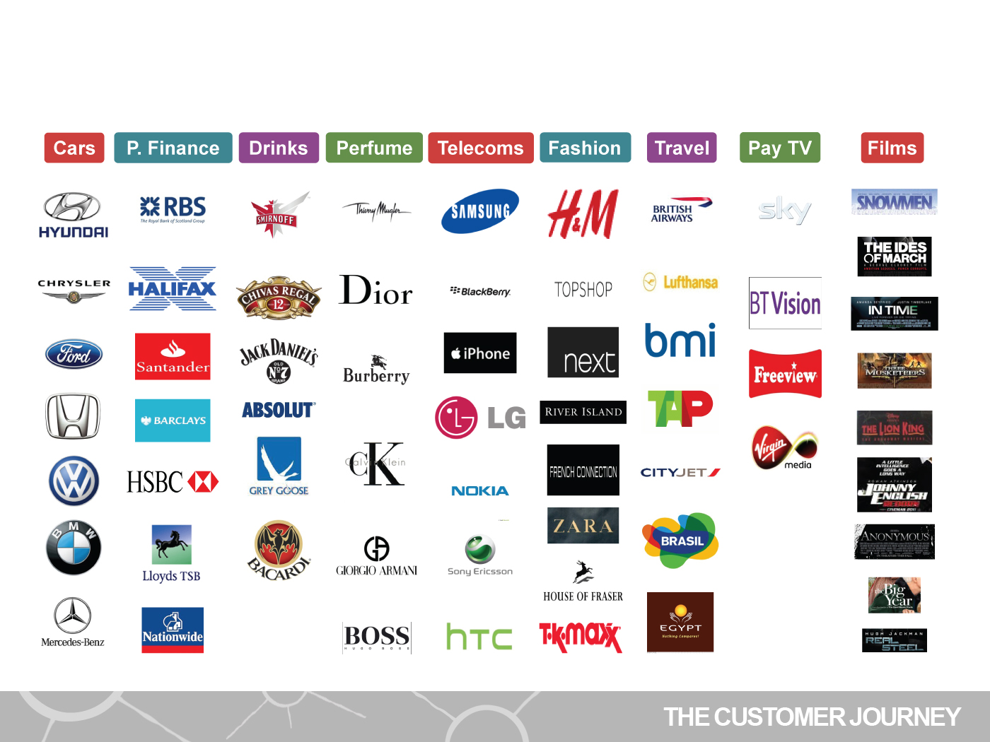
Brands Covered across 9 categories

Slide 17
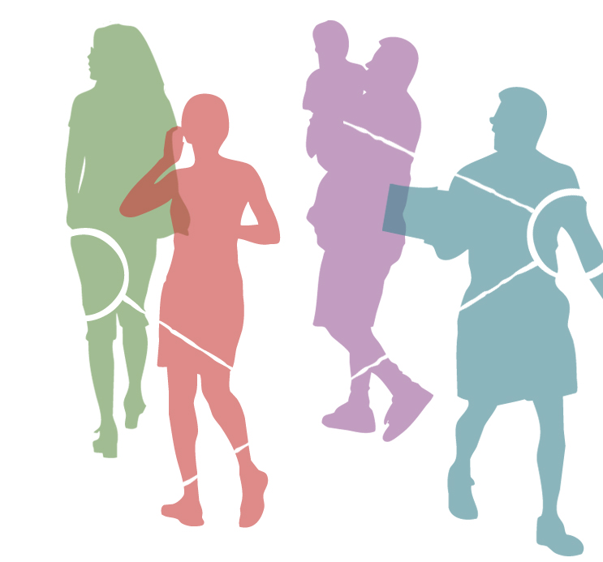
Encounters by Touchpoint Type
Touchpoint Type | Total Reported Encounters
TOTAL | 13,035
TV Ad | 2,293
Used the brand | 2,049
Out of home | 1,914
Word of mouth | 1,542
Elsewhere ^{(a)} | 1,514
Read About | 893
Online Ad | 775
DM / Doordrop | 710
Magazine Ad | 547
Newspaper Ad | 531
Radio Ad | 267
a = Elsewhere is self reported by the panellists.
The majority of the encounters are likely to have been exposure in-store, in shop windows, on-street, in search or in non-advertising media editorial

Slide 18

Number of Reported Encounters
Categories | Total Reported Encounters | Average Number of Encounters
TOTAL | 13,035 | 6.1
Fashion | 2,618 | 11.4
Perfume | 1,303 | 7.1
Telecoms | 2,061 | 6.1
Spirits | 1,715 | 5.5
Films | 1,539 | 5.5
Travel | 1,187 | 5.2
Pay TV | 965 | 4.7
Cars | 1,100 | 4.6
Personal Finance | 547 | 4.3

Slide 19

Impact of Encounters
65% of reported encounters resulted in some kind of ‘feel’ or ‘do’ response. 28% of encounters did both
Emotional Response (Feel)
Action Response (Do)
More interested
More excited
More familiar with the brand
More likely to recommend the brand
I enjoyed the encounter
Worried about using it
I just wasted my time
I’d consider it in the future
The brand understands its customers
Decided to buy the brand online
Decided to buy the brand in store
Searched for information online
Searched for information via my mobile
Talked to people about it
Recommended it to others
Signed up for updates
Rethought my opinion of the brand
Looked at their product range

Slide 20
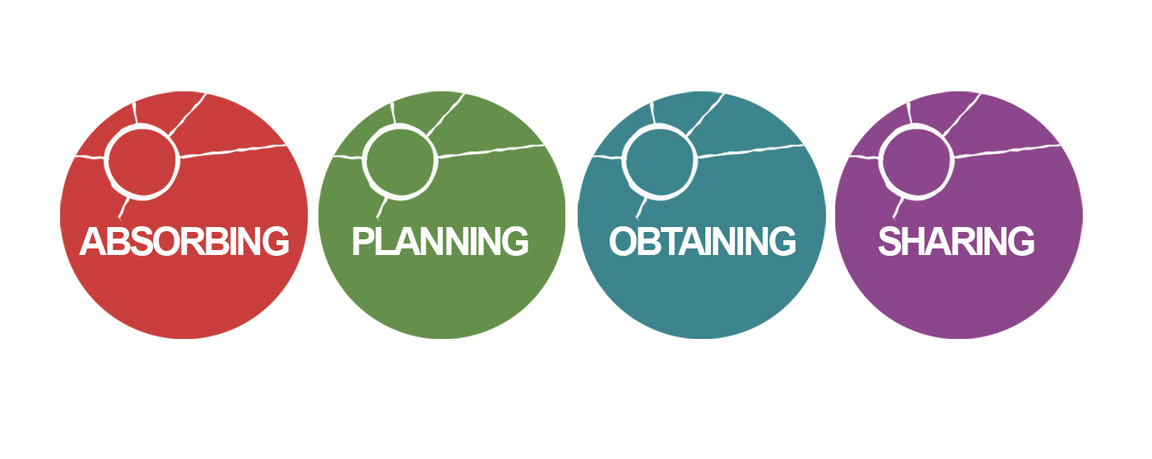
% of people who remained in same stage
70%
46%
24%
38%
Average across all product categories covered by the project

Slide 21
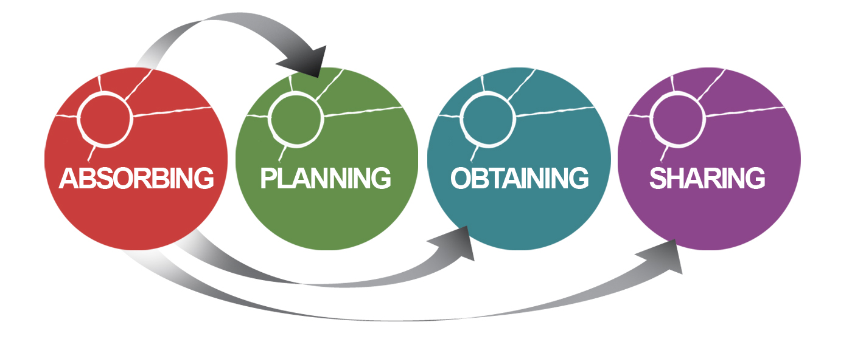
Customer Journey Movements
15%
70%
5%
10%
46%
24%
38%
Average across all product categories covered by the project

Slide 22
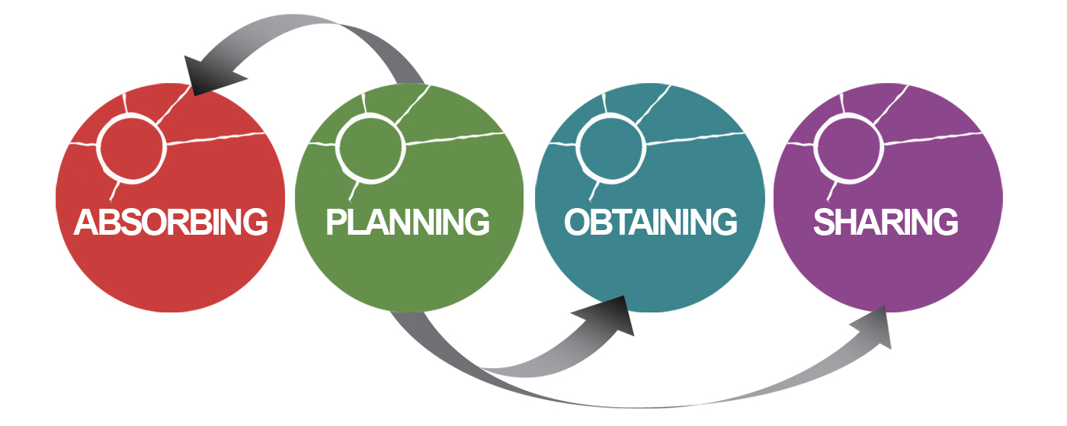
Customer Journey Movements
35%
46%
10%
9%
70%
24%
38%
Average across all product categories covered by the project

Slide 23
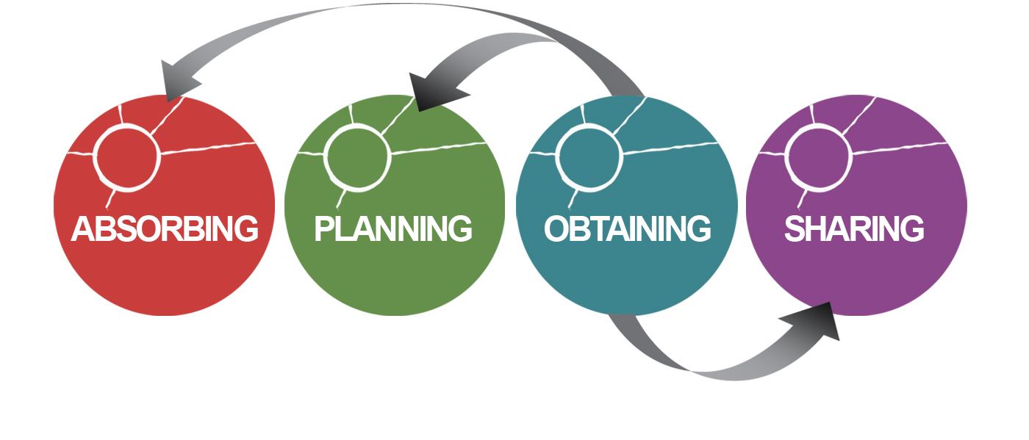
Customer Journey Movements
28%
30%
24%
18%
70%
46%
38%
Average across all product categories covered by the project

Slide 24
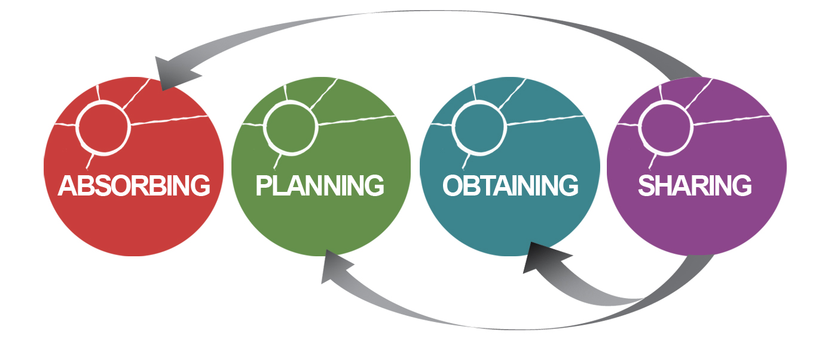
Customer Journey Movements
39%
38%
14%
9%
70%
46%
24%
Average across all product categories covered by the project

Slide 25
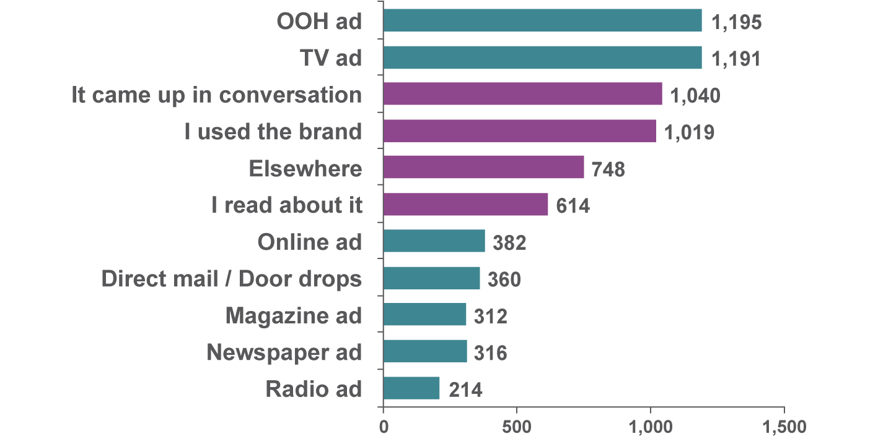
Total encounters which generated a “feel” response

Slide 26
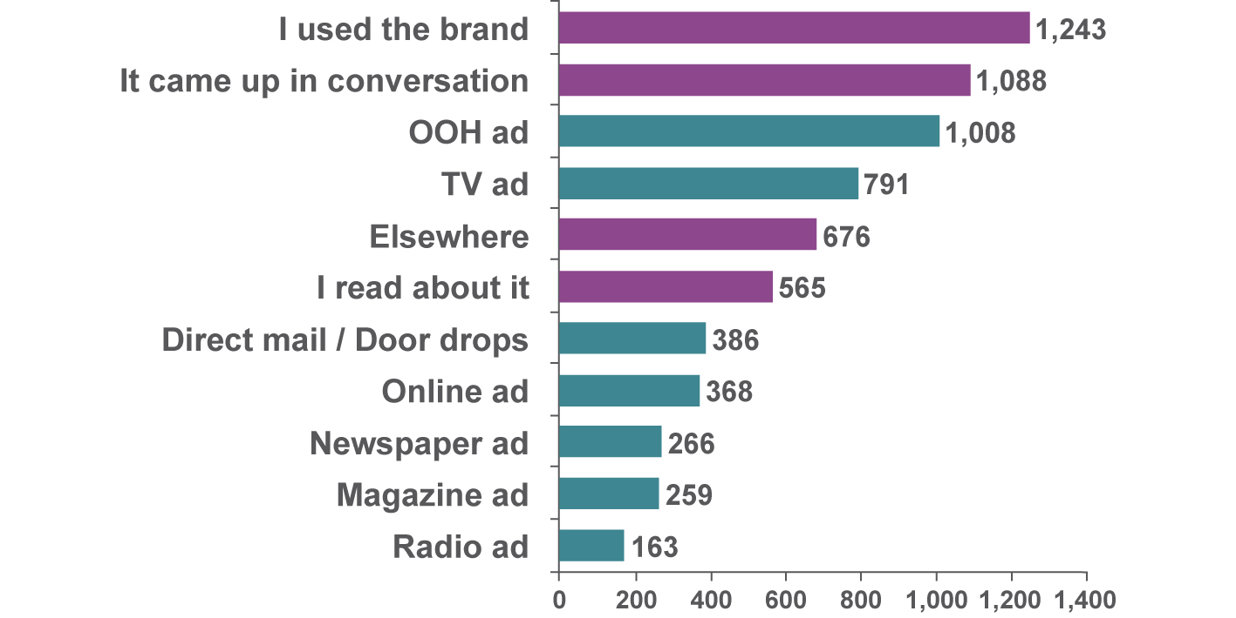
Total encounters which generated a “do” response

Slide 27

Impact of each touchpoint on ‘feel’ and ‘do’ responses
% of encounters resulting in a ‘do’ response
% of encounters resulting in a ‘feel’ response

Slide 28
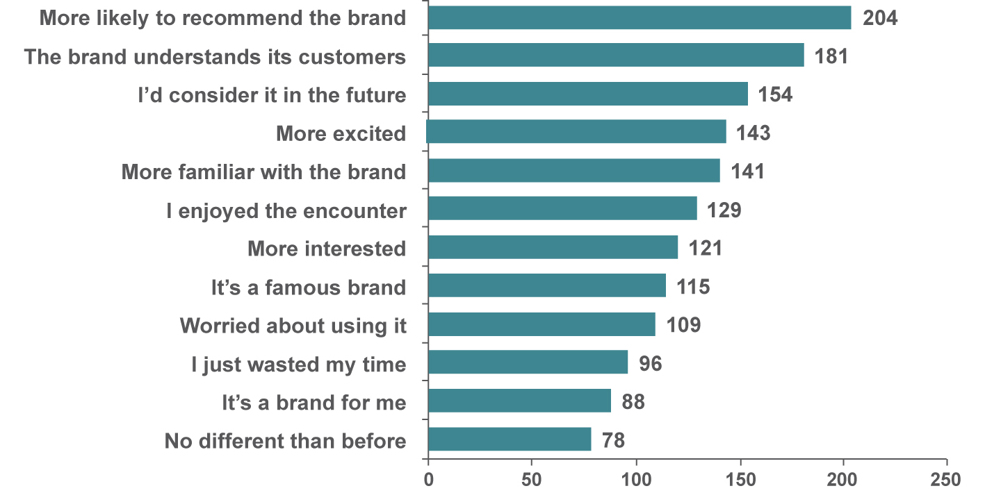
Outdoor encounters are more likely to provoke positive feelings
Index of agreement versus all encounters average (media and non media)

Slide 29
Online and Outdoor ads generate search

Slide 30
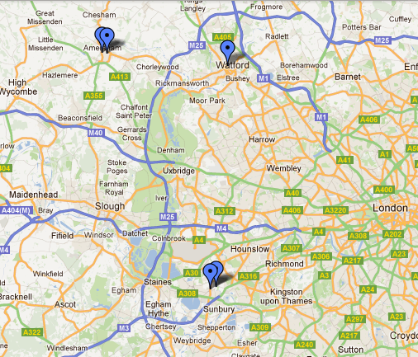
A Customer Journey – Pay TV services
Male 25-34, ABC1, iPhone, Moved from Obtain to Share
9th Oct – Out & About
Sky – Newspaper Ad
Looked at product range
Felt it’s a famous brand
8th Oct – Public Transport
Sky – Poster
Talked to people about it
Looked at product range
More Interested
10th Oct – Neighbour’s house
BT Vision – Used the brand
Looked at product range
More familiar with the brand
Felt it’s a famous brand
5th Oct – Public Transport
Virgin Media – Poster
Searched for more info
It’s a brand for me
4th Oct – Home
Virgin Media – Online Ad
Talked to people about it
More Interested
Post Survey
Sky owner
Pre-Survey
Freeview user

Slide 31

Advertising media are responsible for >50% SOV of effective encounters: where people have moved forwards along the journey

Slide 32
OOH’s Share of Voice (SoV) of effective encounters increases the closer a person moves to obtaining
Absorbing = moved to planning, obtaining or sharing
Planning = moved to obtaining or sharing
Obtaining = moved to sharing or absorbing
Sharing = moved to absorbing, planning or obtaining

Slide 33

OOH’s Share of Voice (SoV) of effective encounters increases the closer a person moves to obtaining

Slide 34

Research Summary
Media advertising drives the Customer Journey, but no one medium is the sole answer
Along with TV, OOH dominates effective share of voice
OOH has a powerful influence at every stage of the journey, driving investigation, purchase and recommendation
OOH is strongly linked to mobile search as well as social media
OOH’s audience is responsive and attractive. The people you most reach with outdoor are the people you most want to reach

Slide 35

“So what” for media planners?
Today’s mobile and connected consumers notice outdoor and respond to it . They are young, upmarket, affluent and social – the consumers of the future
Outdoor engages and cuts through with consumers’ feelings and actions: let it be your call to action medium
Outdoor is more than a point of sale medium
  It plugs in seamlessly with mobile, social and search
  Outdoor can amplify a brand message, providing a physical presence in an increasingly virtual world
  It’s a powerful visual branding tool you can intercept customers with in all the right locations
  Outdoor’s effectiveness actually grows with more
  exposures in more outdoor formats

